Slide 1

PID Pendulum
Final Presentation
By: Joe S, Matt H, Austin C, and Kat S

Slide 2
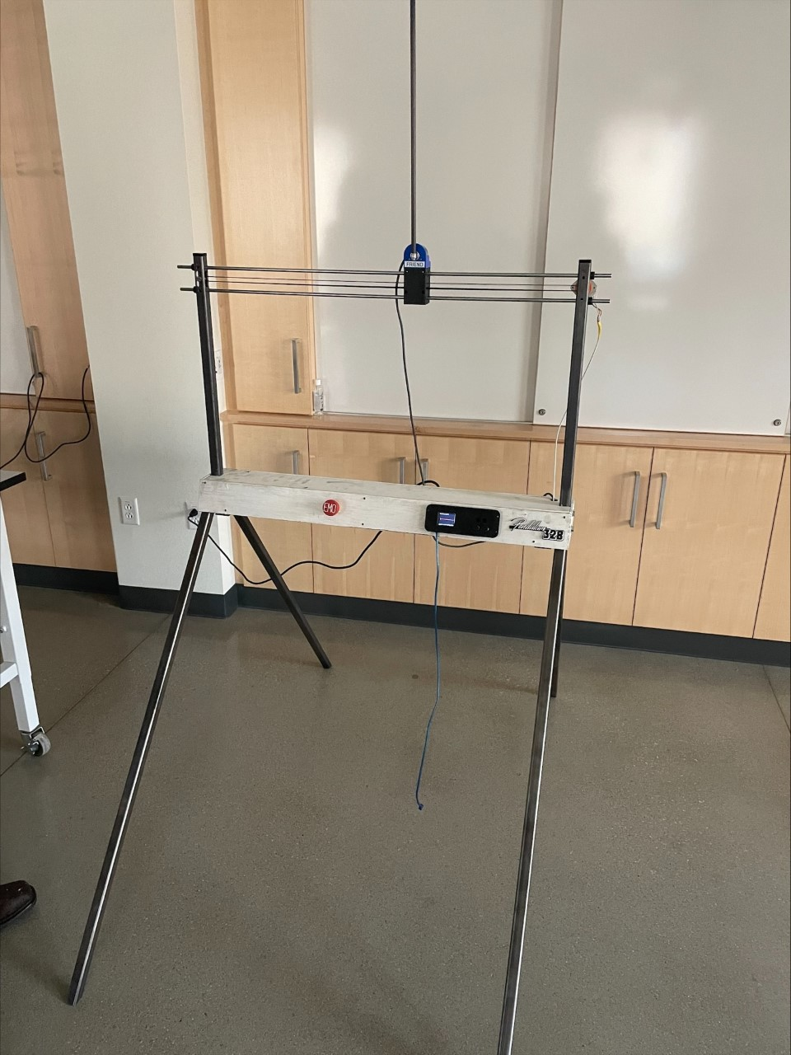
Final Design
Austin

Slide 3

Agenda
Project Description
ConOps Summary
System Requirements Verification
Detailed Design
Mechanical, Electrical, Software
AI&T, Functional Block Diagram
Operational Flowchart
Fabrication and Integration
Comprehensive Performance Testing
Schedule
Project Budget
Conclusion and Lessons Learned
Kay

Slide 4
Concept of Operations Summary
Stakeholders: Educators and Academics, Industrial Training
System Description: PID demonstrator: illustrating physical and digital effects of changing algorithm constants to the user.
Operational Environment: Indoor, high-traffic environment.
Support Environment:
COTS (common off the shelf) parts
Constant Uptime
Constant Interaction
Operating Modes:
Off Mode
Idle Mode
Spin-Up Mode
Autonomous Mode
User Interactive Mode
Risks:
Pinch Points
Swinging Pendulum
Failure
Short Circuit
Overheating
Impact: Hazardous when misused. Requires physical space, and creates waste.
Kat

Slide 5
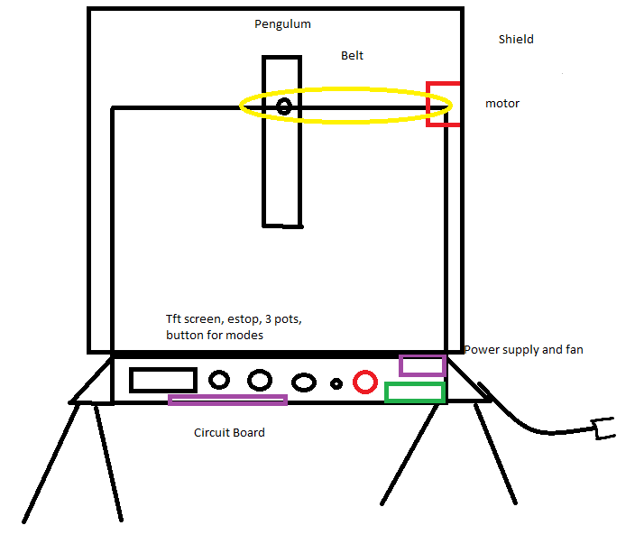
The Initial Idea:
Kat

Slide 6
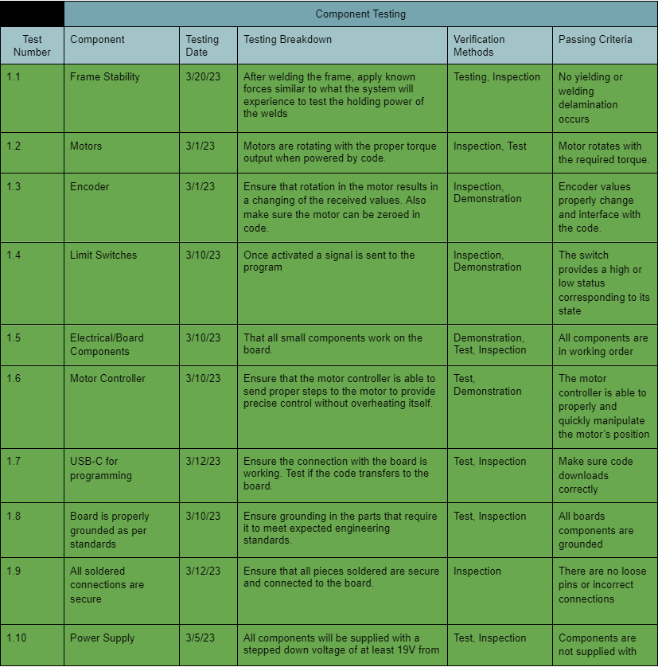
Component Level Requirements
Green = Passed
Blue = Untested
Red = Failed
Matt

Slide 7
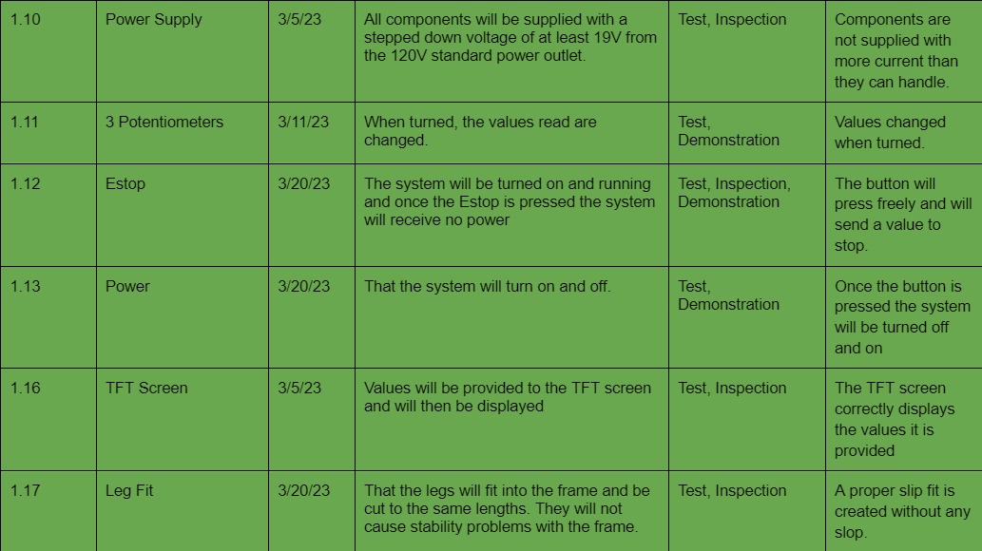
Component Level Requirements (continued)
Matt

Slide 8
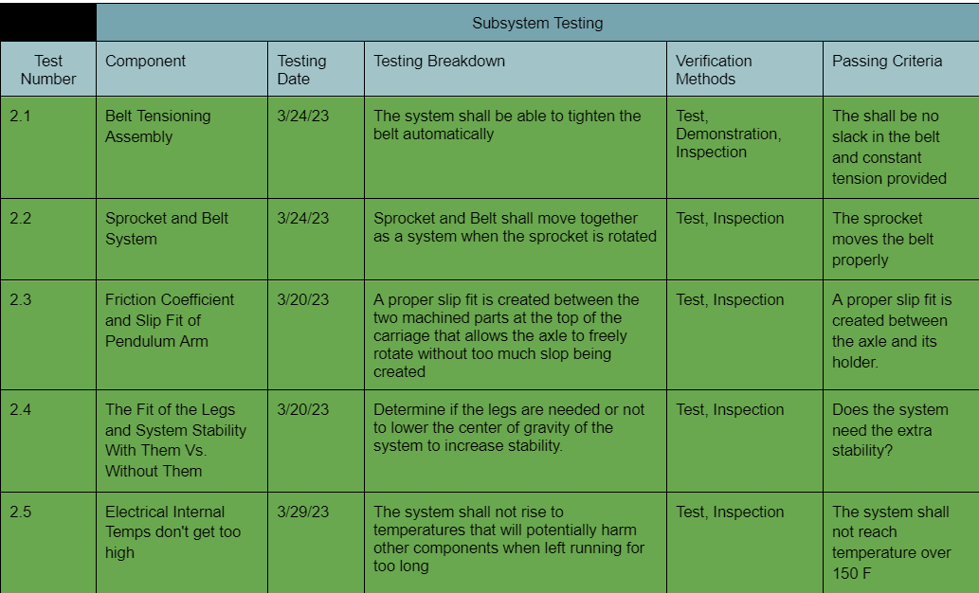
Subsystem Level Requirements
Matt

Slide 9
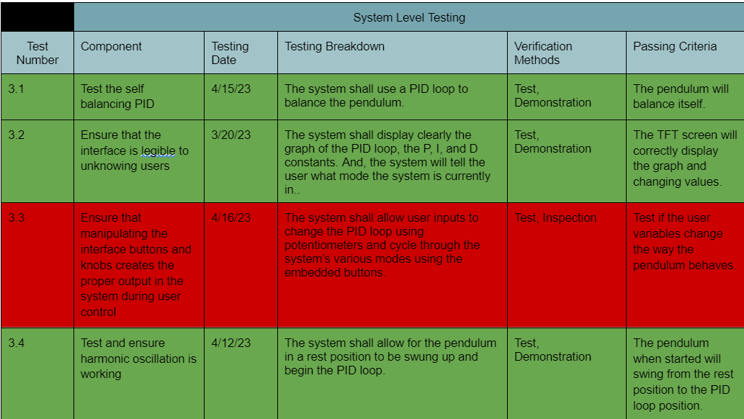
System Level Requirements
Matt

Slide 10
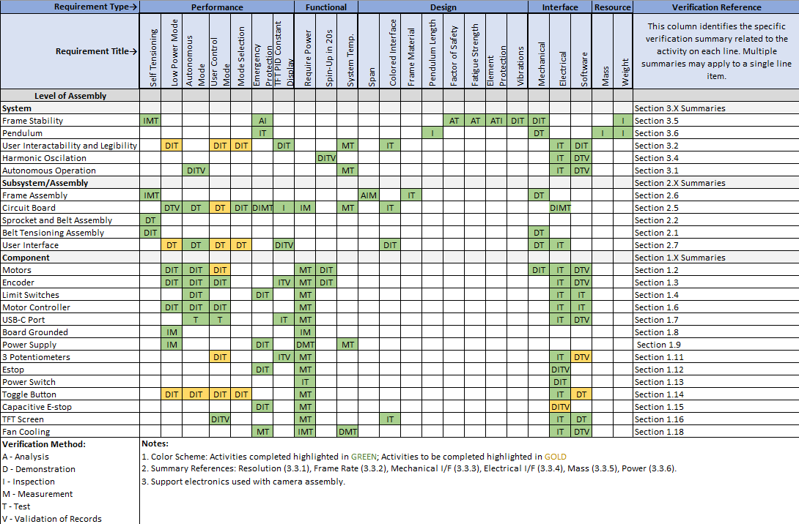
System Requirements Verification
Matt

Slide 11

Harmonic Oscillations
Date: 04/16/2023
Activity Title: Harmonic Oscillations
Activity Location: Joe’s Shop
Configuration: Pendulum, Carriage, Motor, Rods, Belt, Encoder
Operators: Matt, Joe, Austin
Results: Pendulum can go from down position to apex position
Observations: The system struggles to catch the pendulum in the apex position
Activity Conclusion: Successfully swings from rest position to PID loop position
Matt

Slide 12
Self Balancing
Date: 04/16/2023
Activity Title: Self balancing
Activity Location: Joe’s Shop
Configuration: Pendulum, Carriage, Motor, Rods, Belt, Encoder
Operators: Matt, Joe, Austin
Results: Pendulum can balance itself for approximately 20-50 seconds
Observations: The motor does not have enough torque to meet our acceleration requirements
Activity Conclusion: Successfully balances itself
Matt

Slide 13
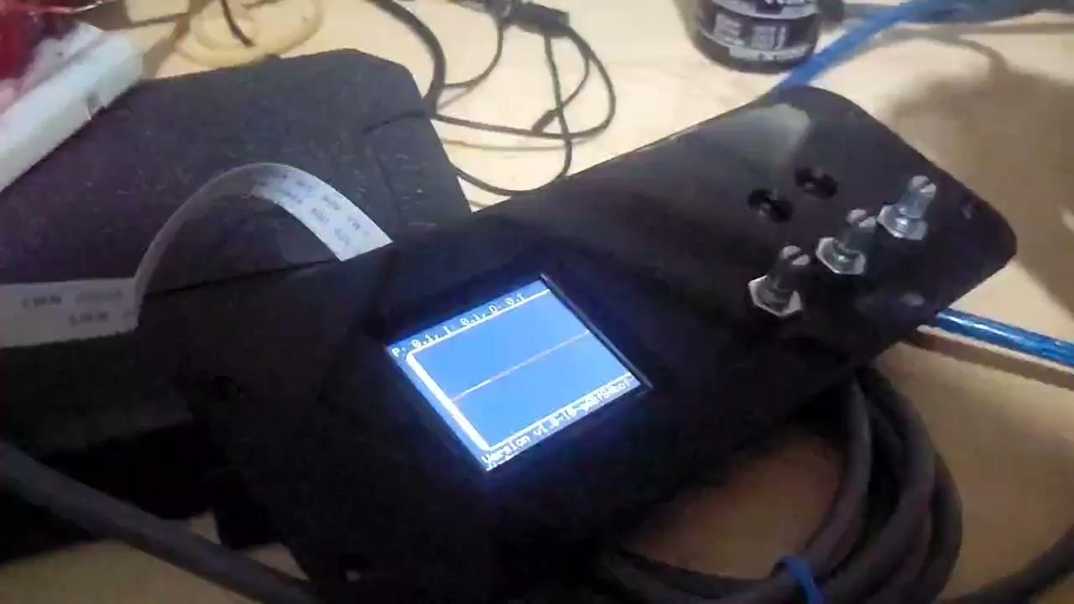
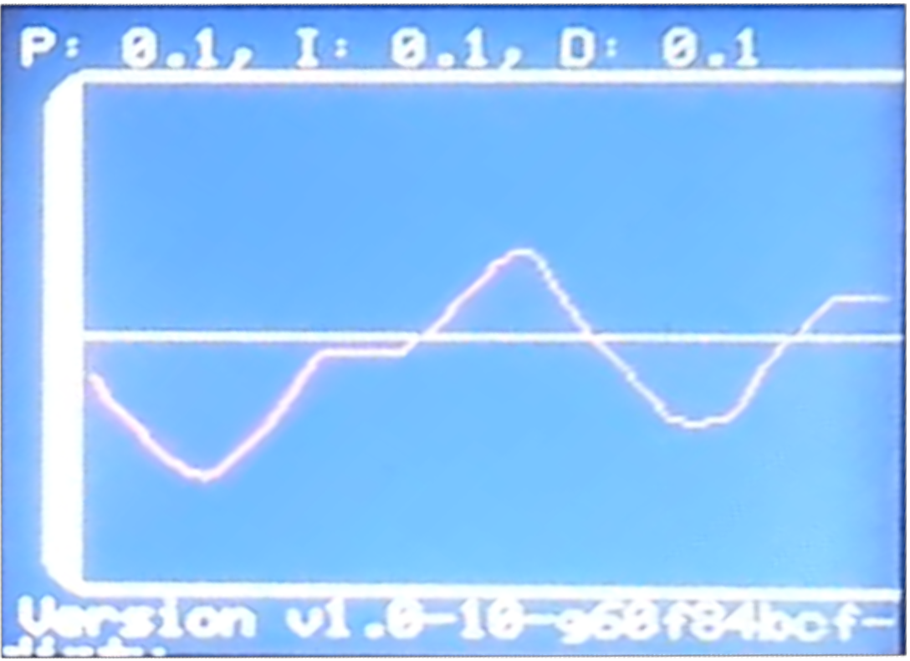
TFT Screen
Date: 04/16/2023
Activity Title: TFT Screen
Activity Location: Joe’s Shop
Configuration: TFT Screen, given inputs
Operators: Joe
Results: Displays harmonic oscillations
Observations: TFT screen displays values accordingly
Activity Conclusion: Successfully displays graph and changing values
Matt

Slide 14
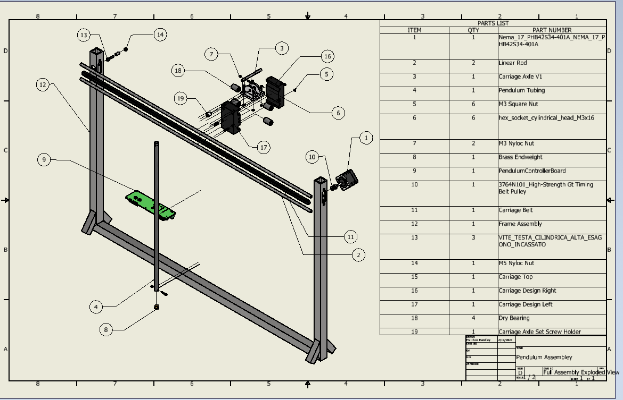
Detailed Design
Matt

Slide 15
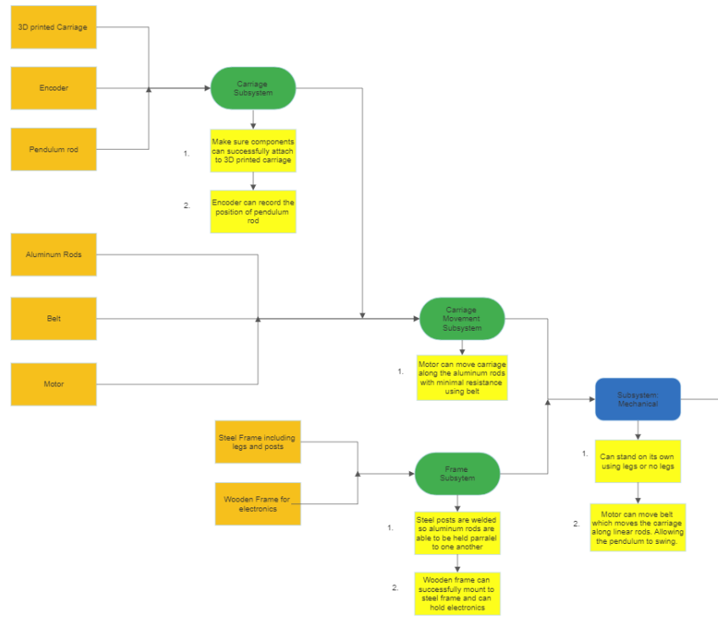
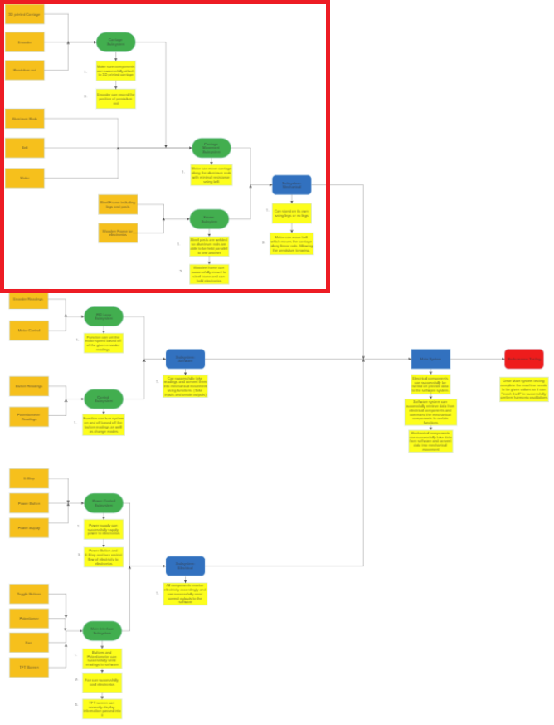
Integration & Test Flow
Austin

Slide 16
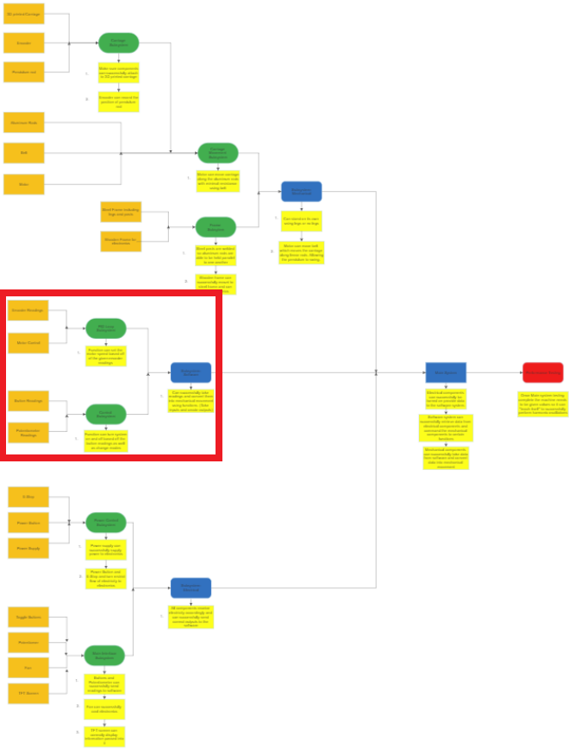
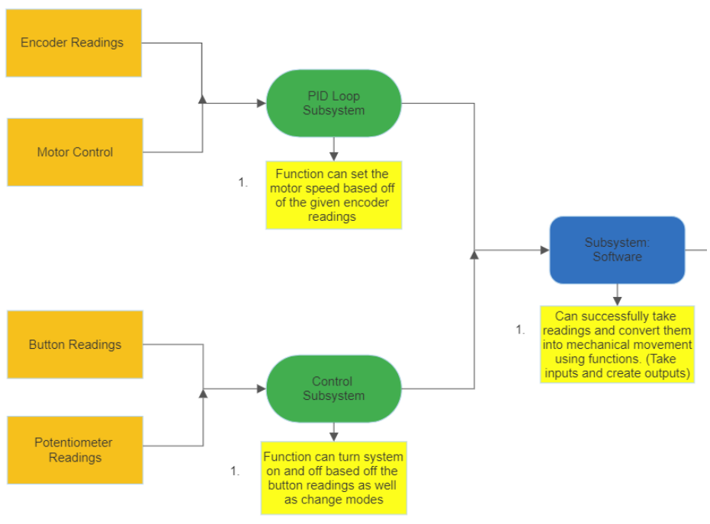
AI&T Flow (cont.)
Austin

Slide 17
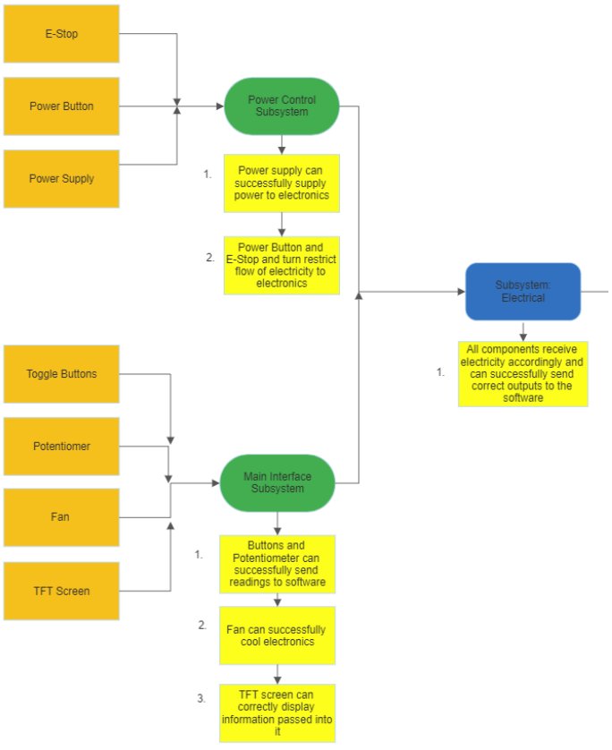
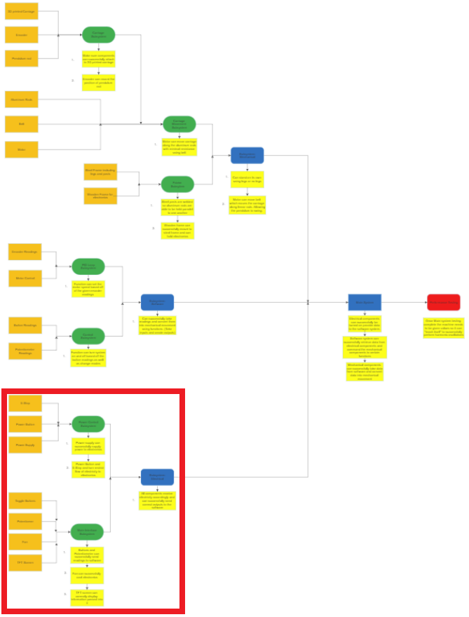
AI&T Flow (cont.)
Austin

Slide 18
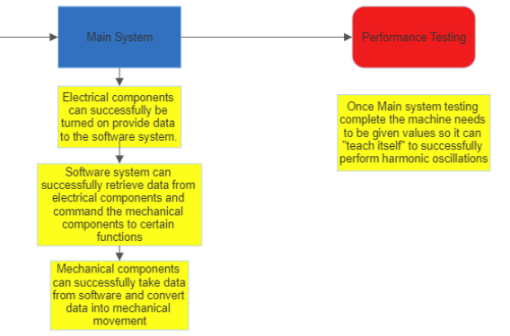
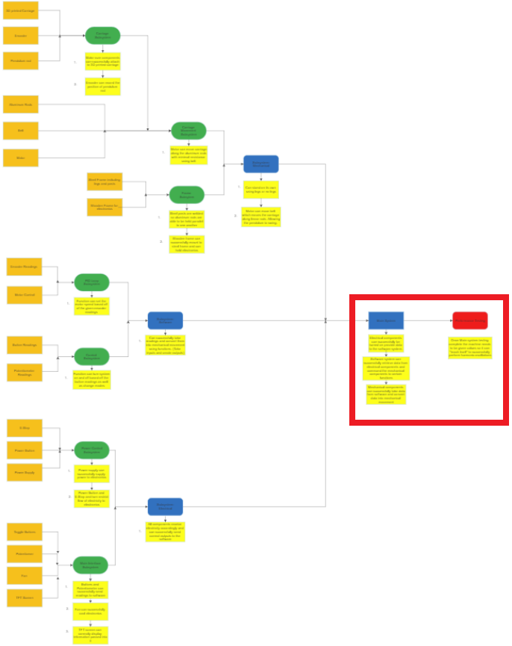
AI&T Flow (cont.)
Austin

Slide 19
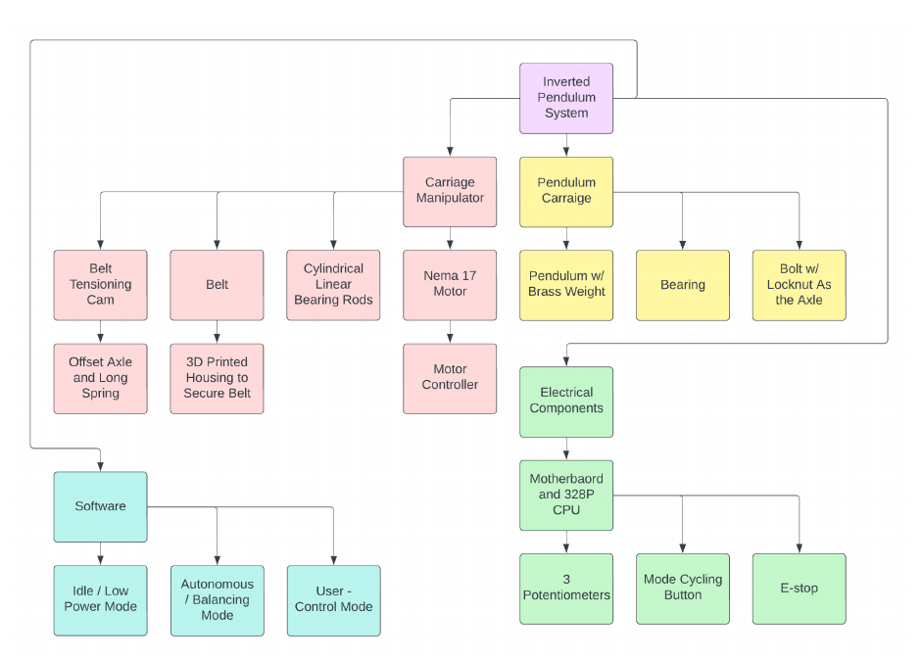
System Functional Block Diagram
Austin

Slide 20
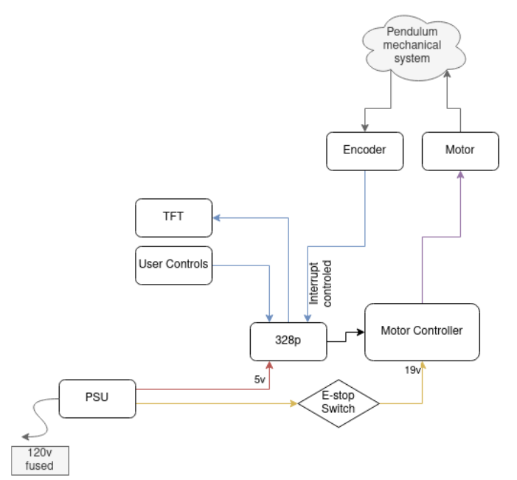
Operational Flow Chart
Austin

Slide 21



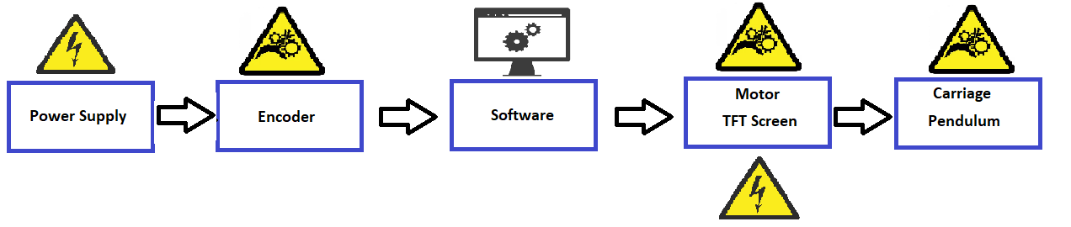
Subsystem Definition
Mechanical
Carriage
Aluminium Rods
Steel Frame
Wooden Frame
Motor (output)
Encoder (input)
Software
Encoder reading
Motor control
Potentiometers readings
Electrical
Power switch
Emergency stop
Power supply
TFT screen
Austin

Slide 22
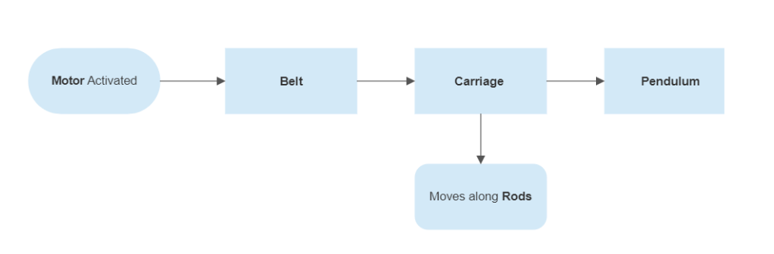
Subsystem 1 Mechanical Design
Joe

Slide 23
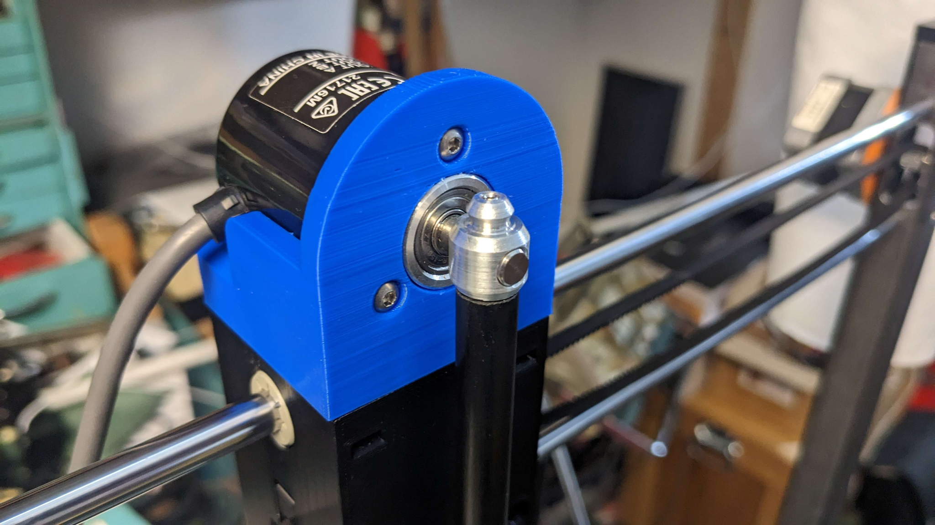
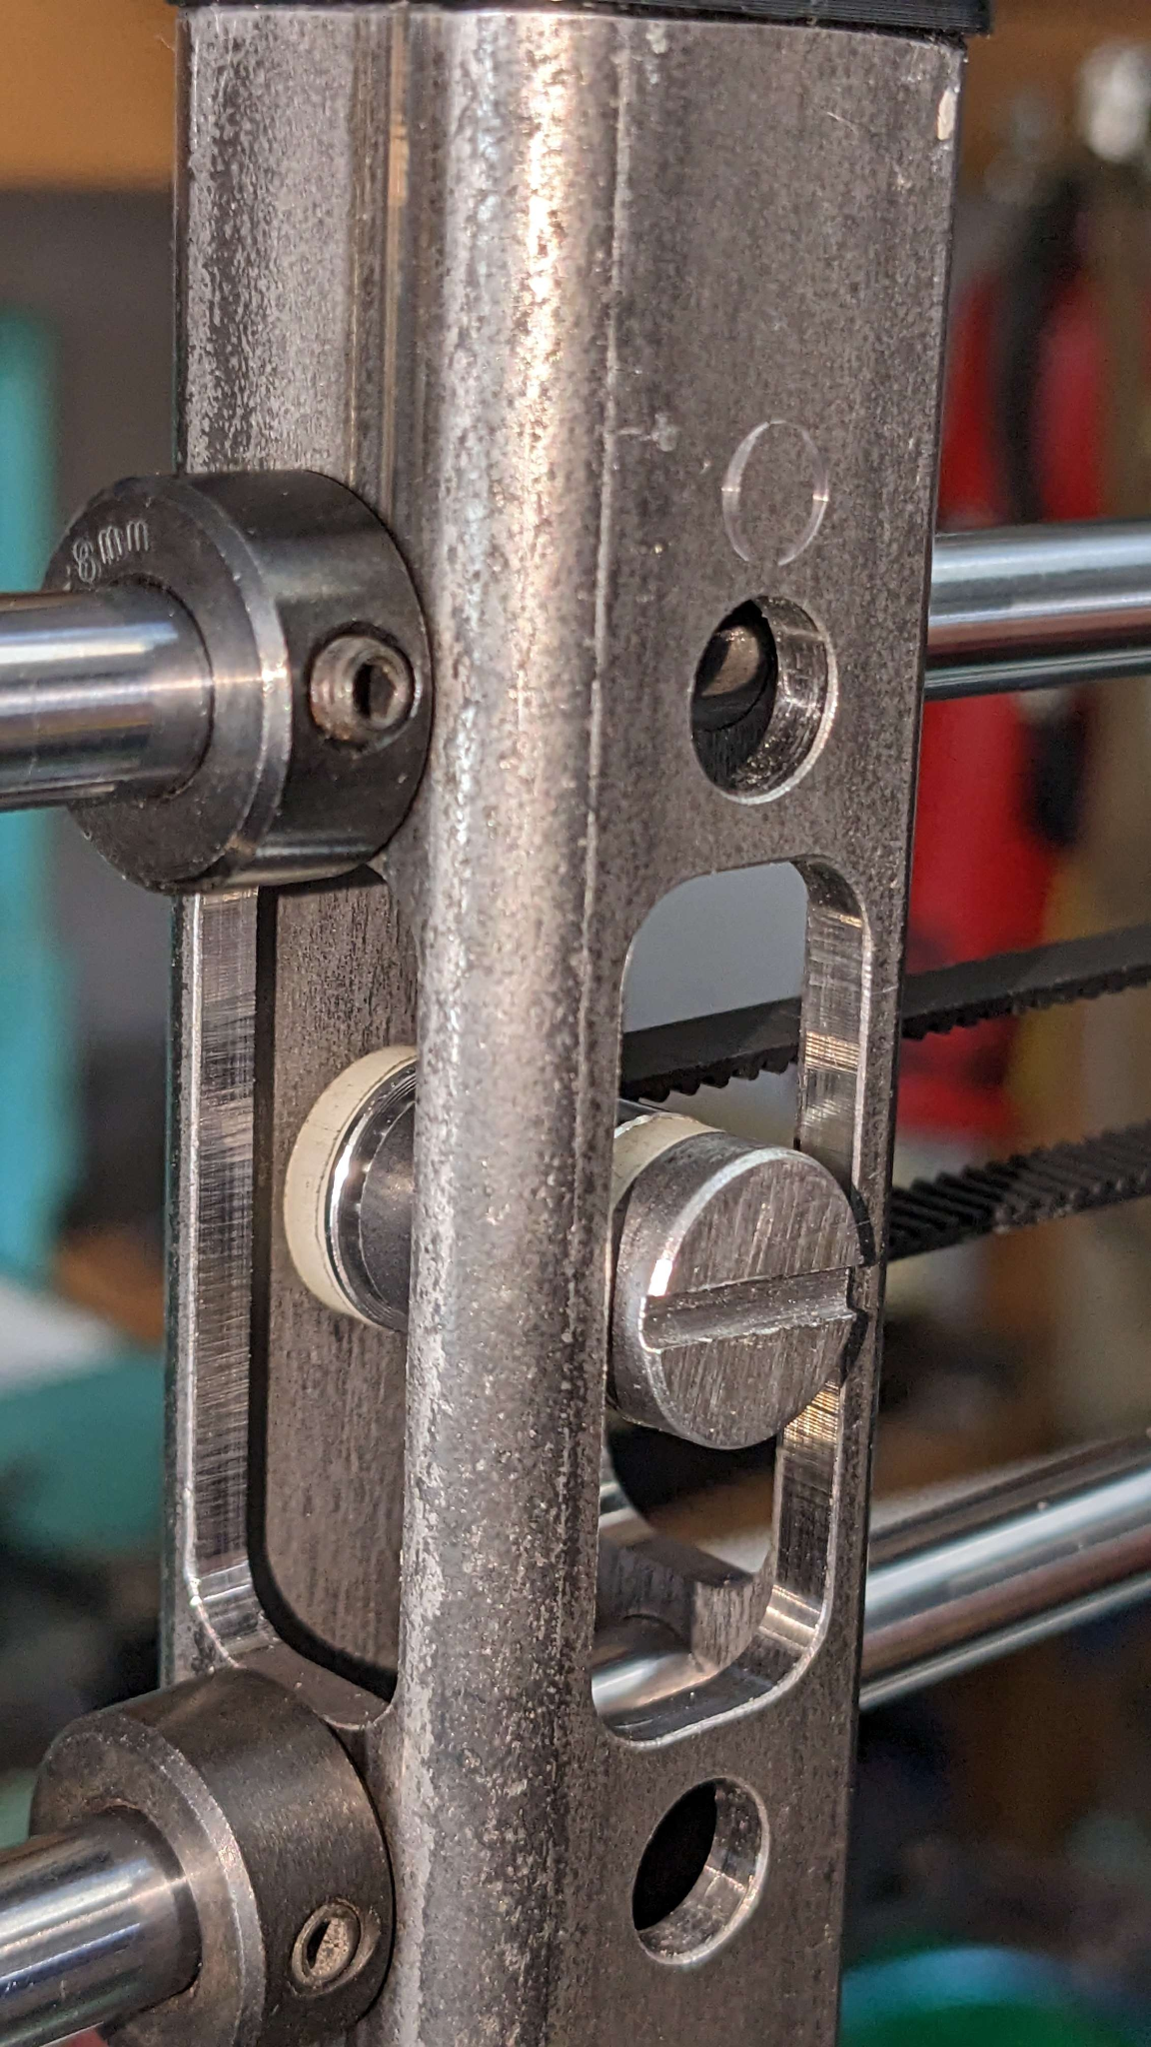
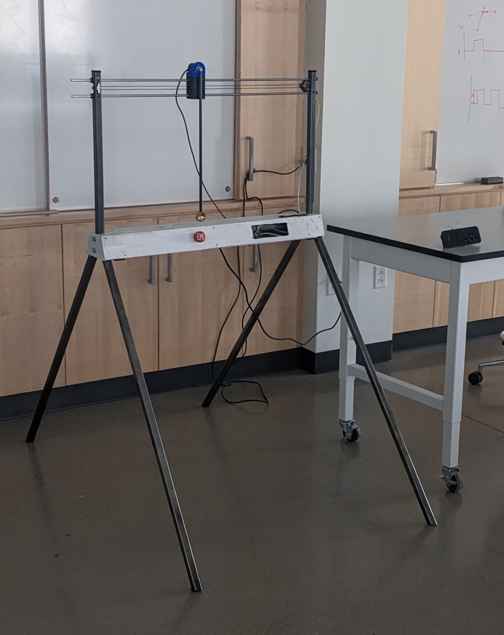
Subsystem 1 Mechanical Design
Carriage:
Self Tensioning Cam
Full System Assembly:
Joe

Slide 24
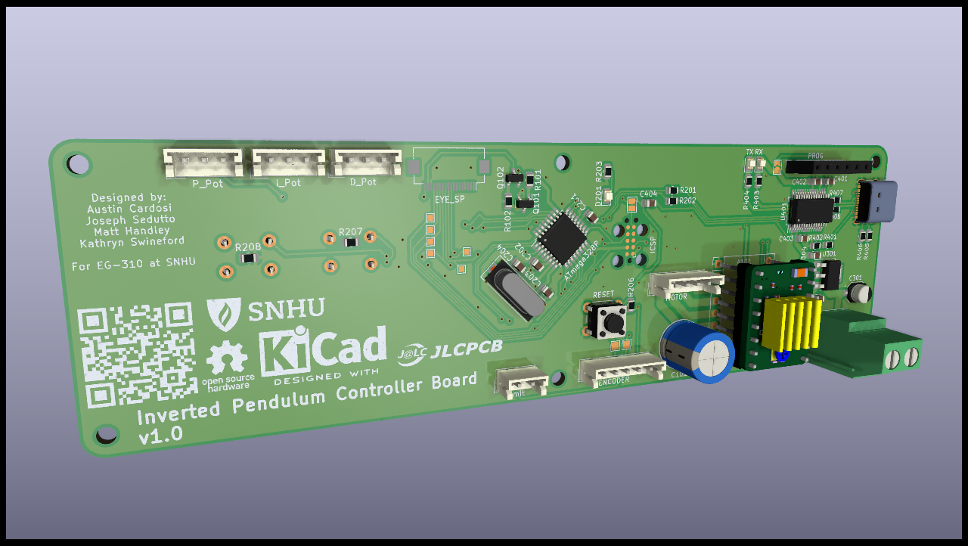
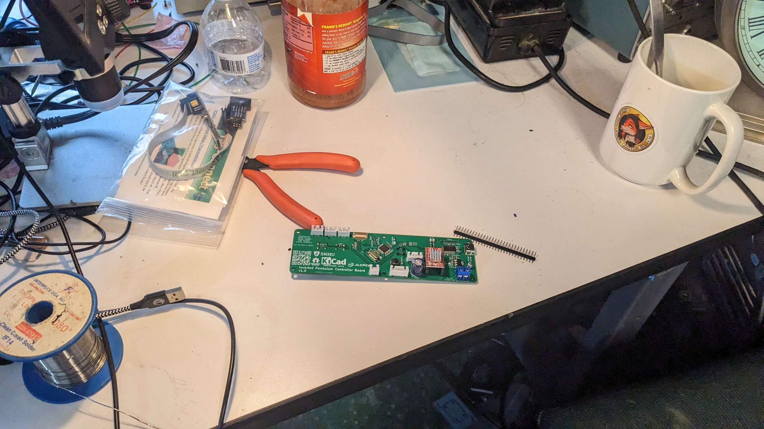
Subsystem 2 Electrical Design
Joe

Slide 25
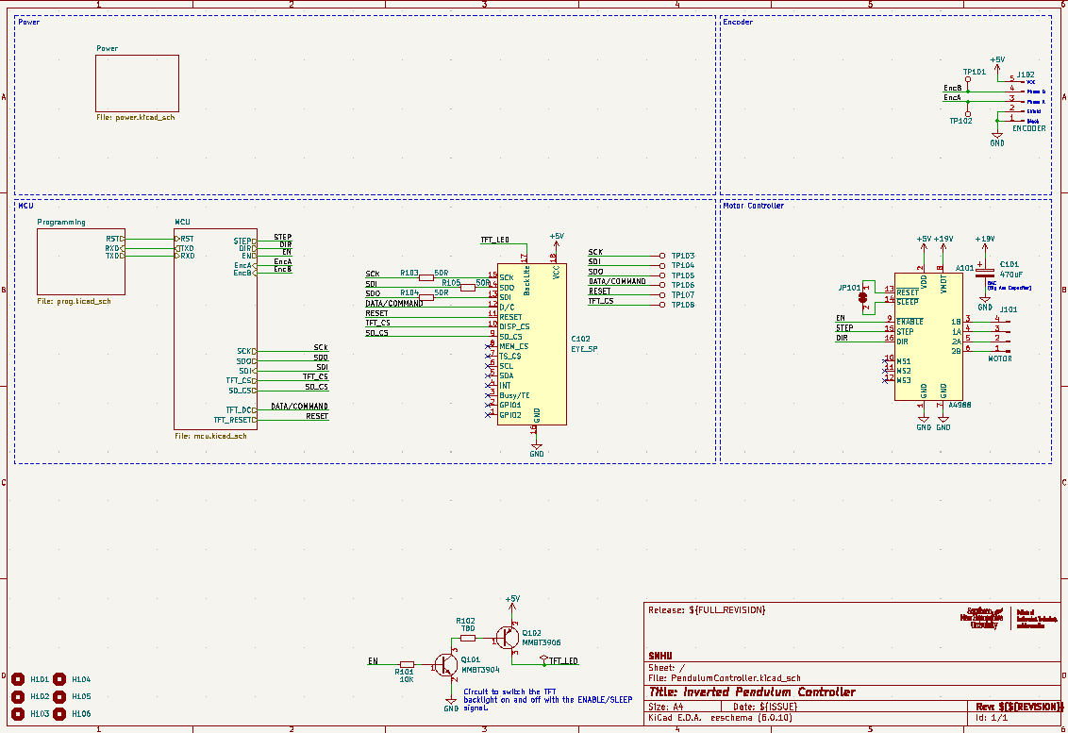
Subsystem 2 Electrical Design
Joe

Slide 26
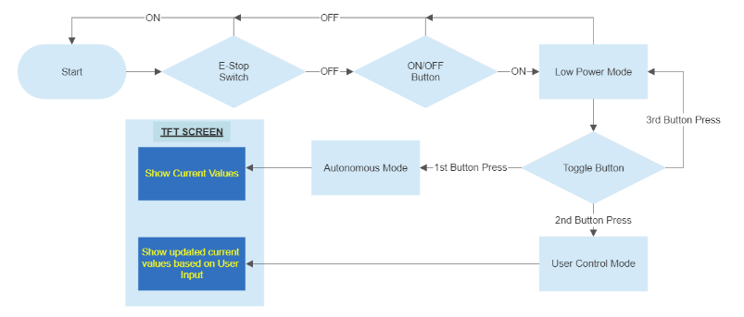
Subsystem 3 Software Design
Joe

Slide 27
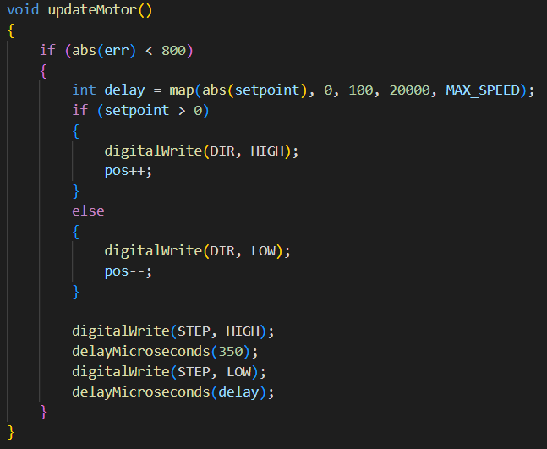
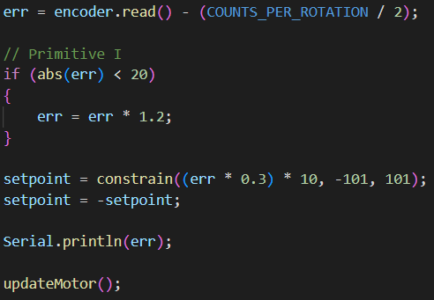
Subsystem 3 Software Design
PID Balancing Loop:
Joe

Slide 28
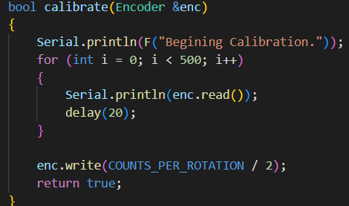
Subsystem 3 Software Design
Encoder Calibration:
Joe

Slide 29
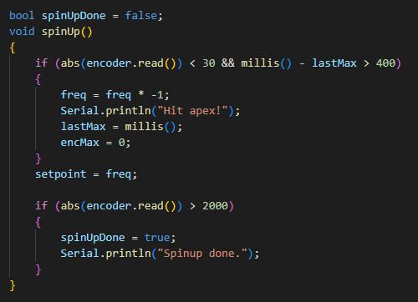
Subsystem 3 Software Design
Spin-Up Code
Joe

Slide 30
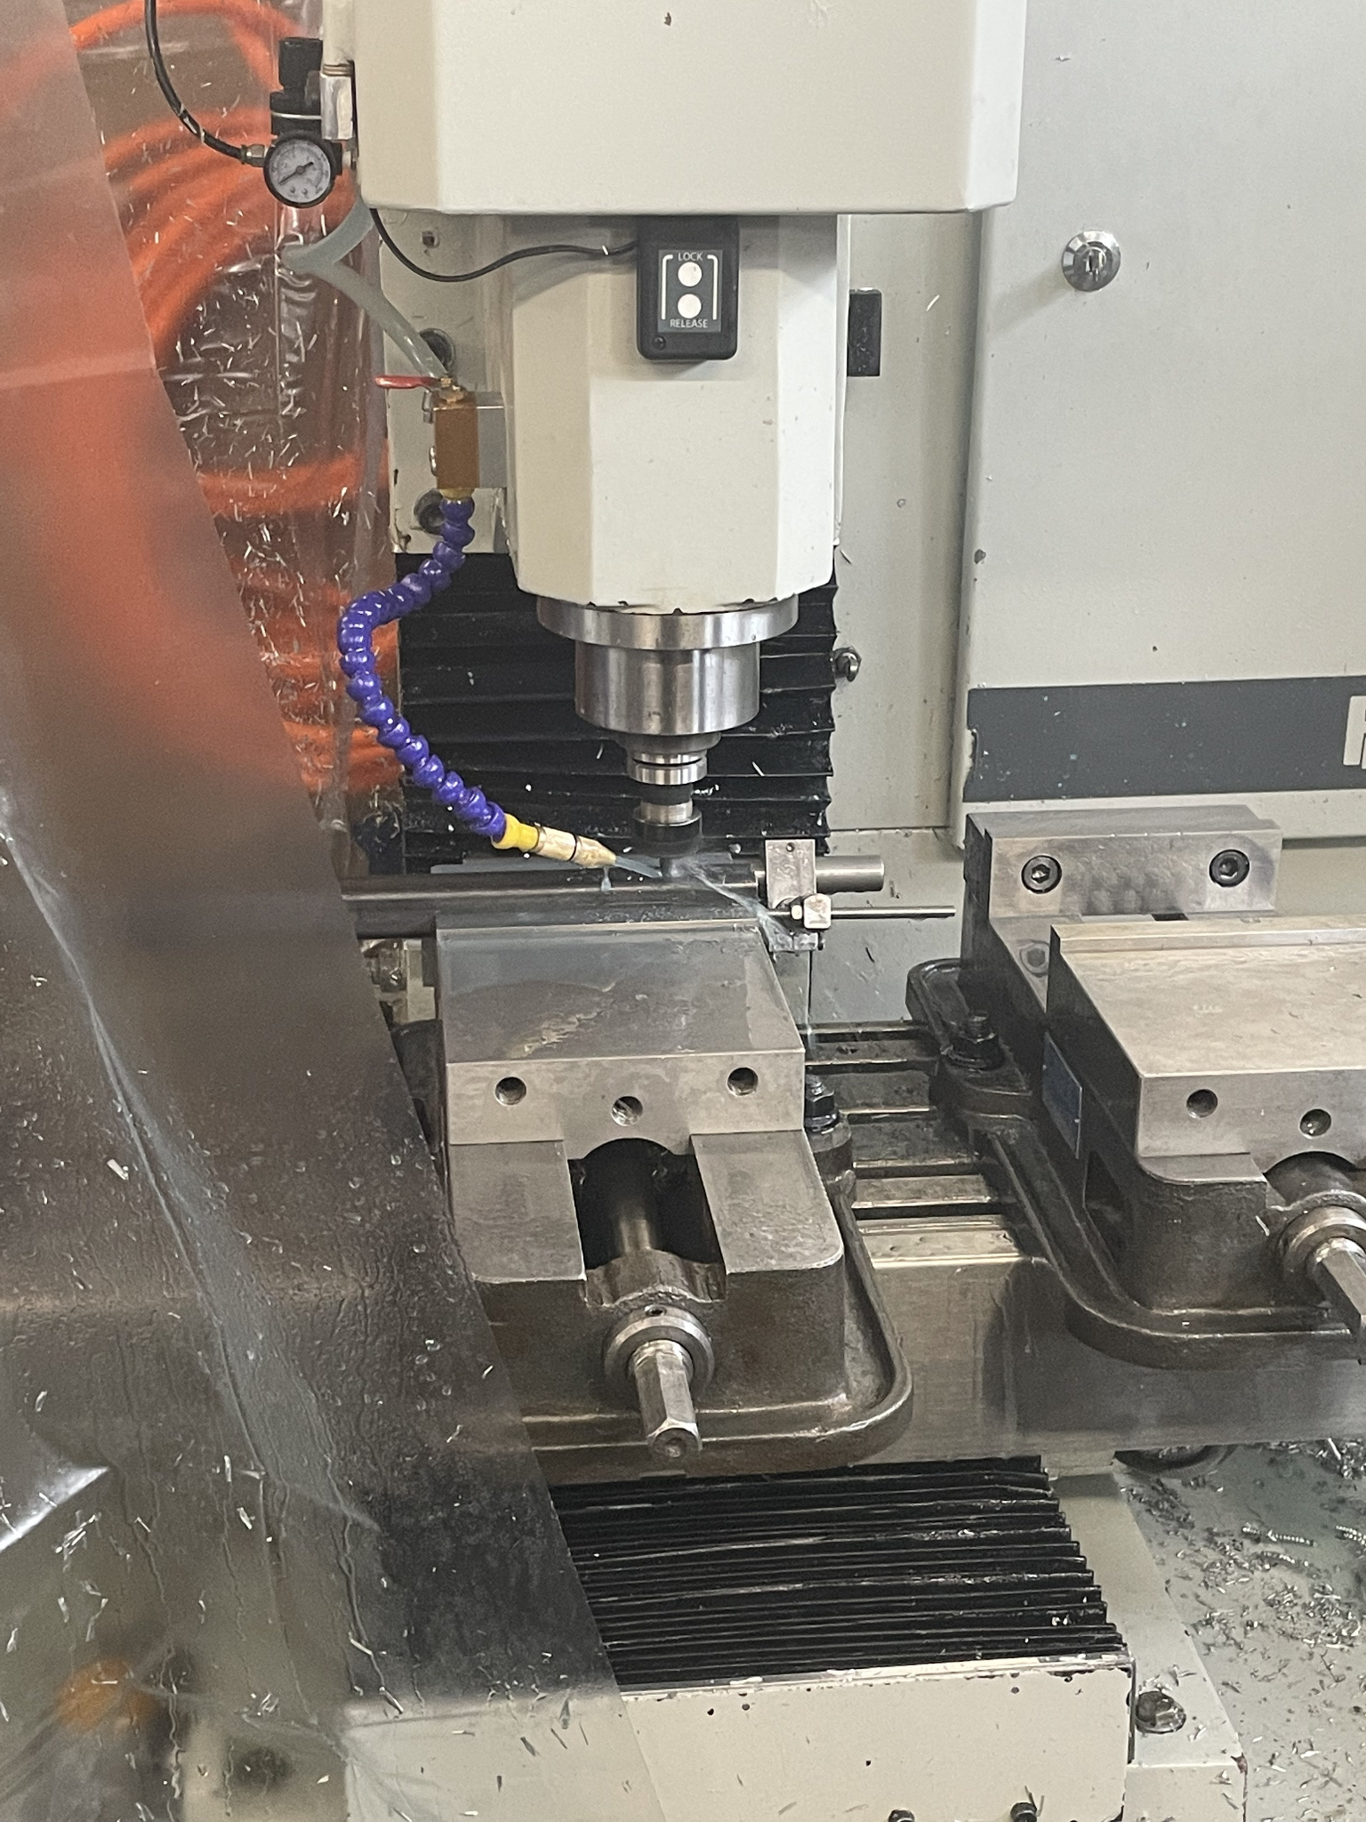
Fabrication & Integration
Matt

Slide 31
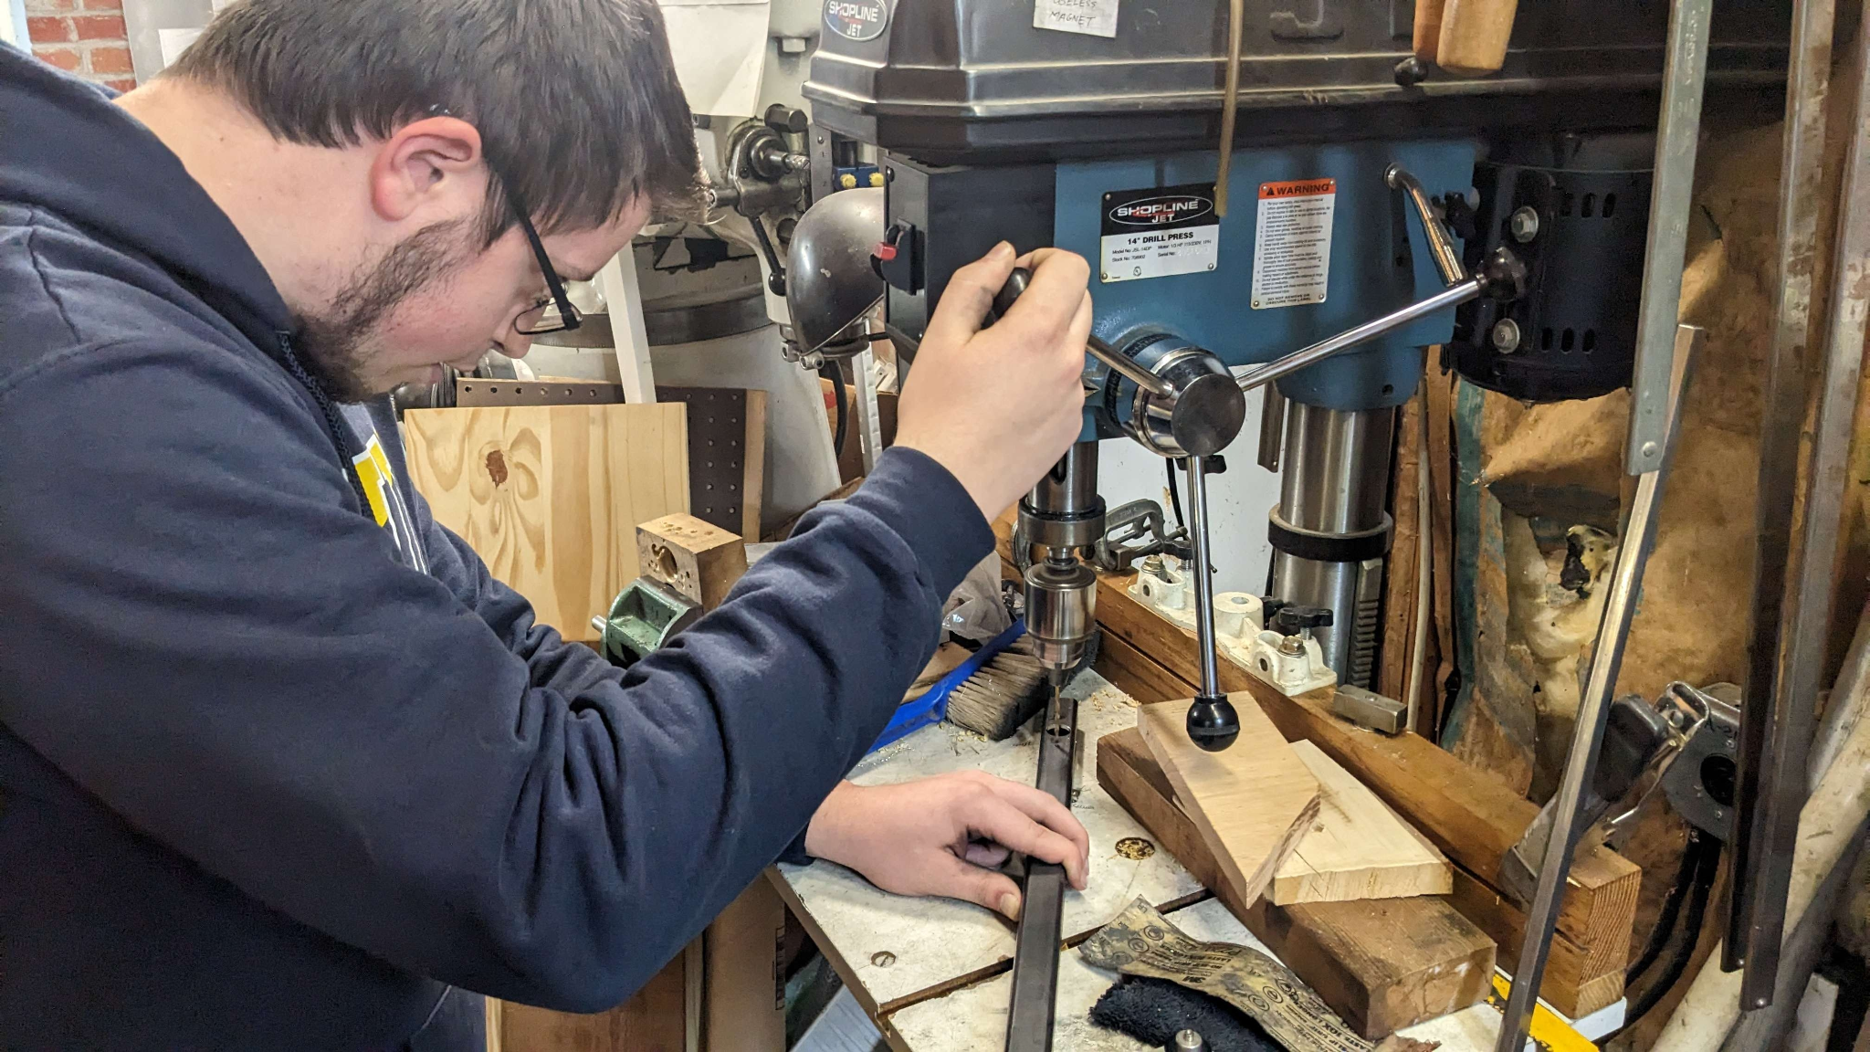
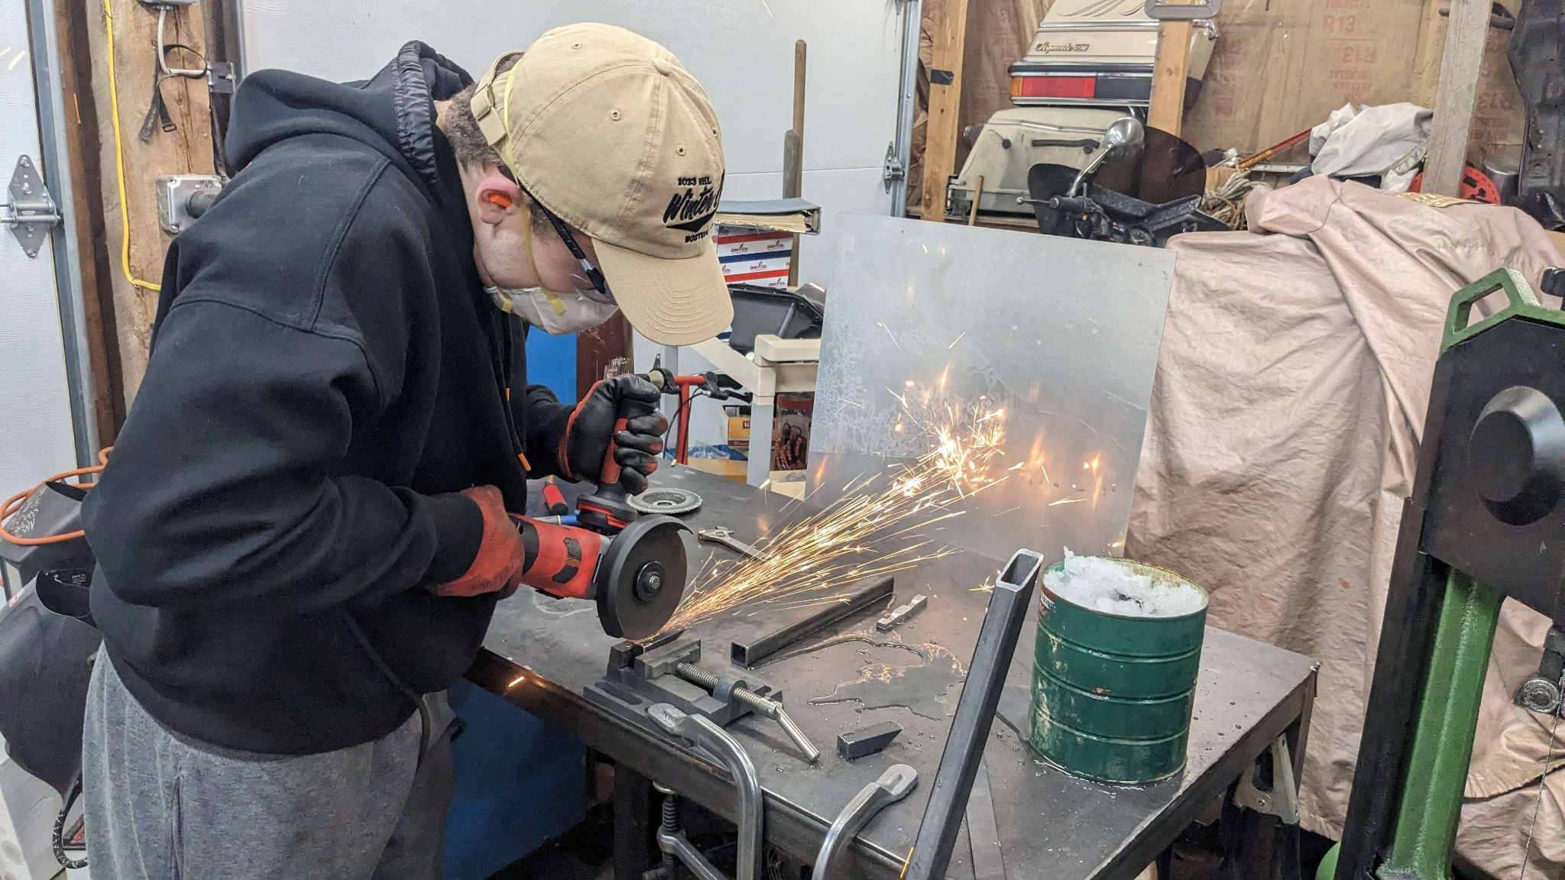
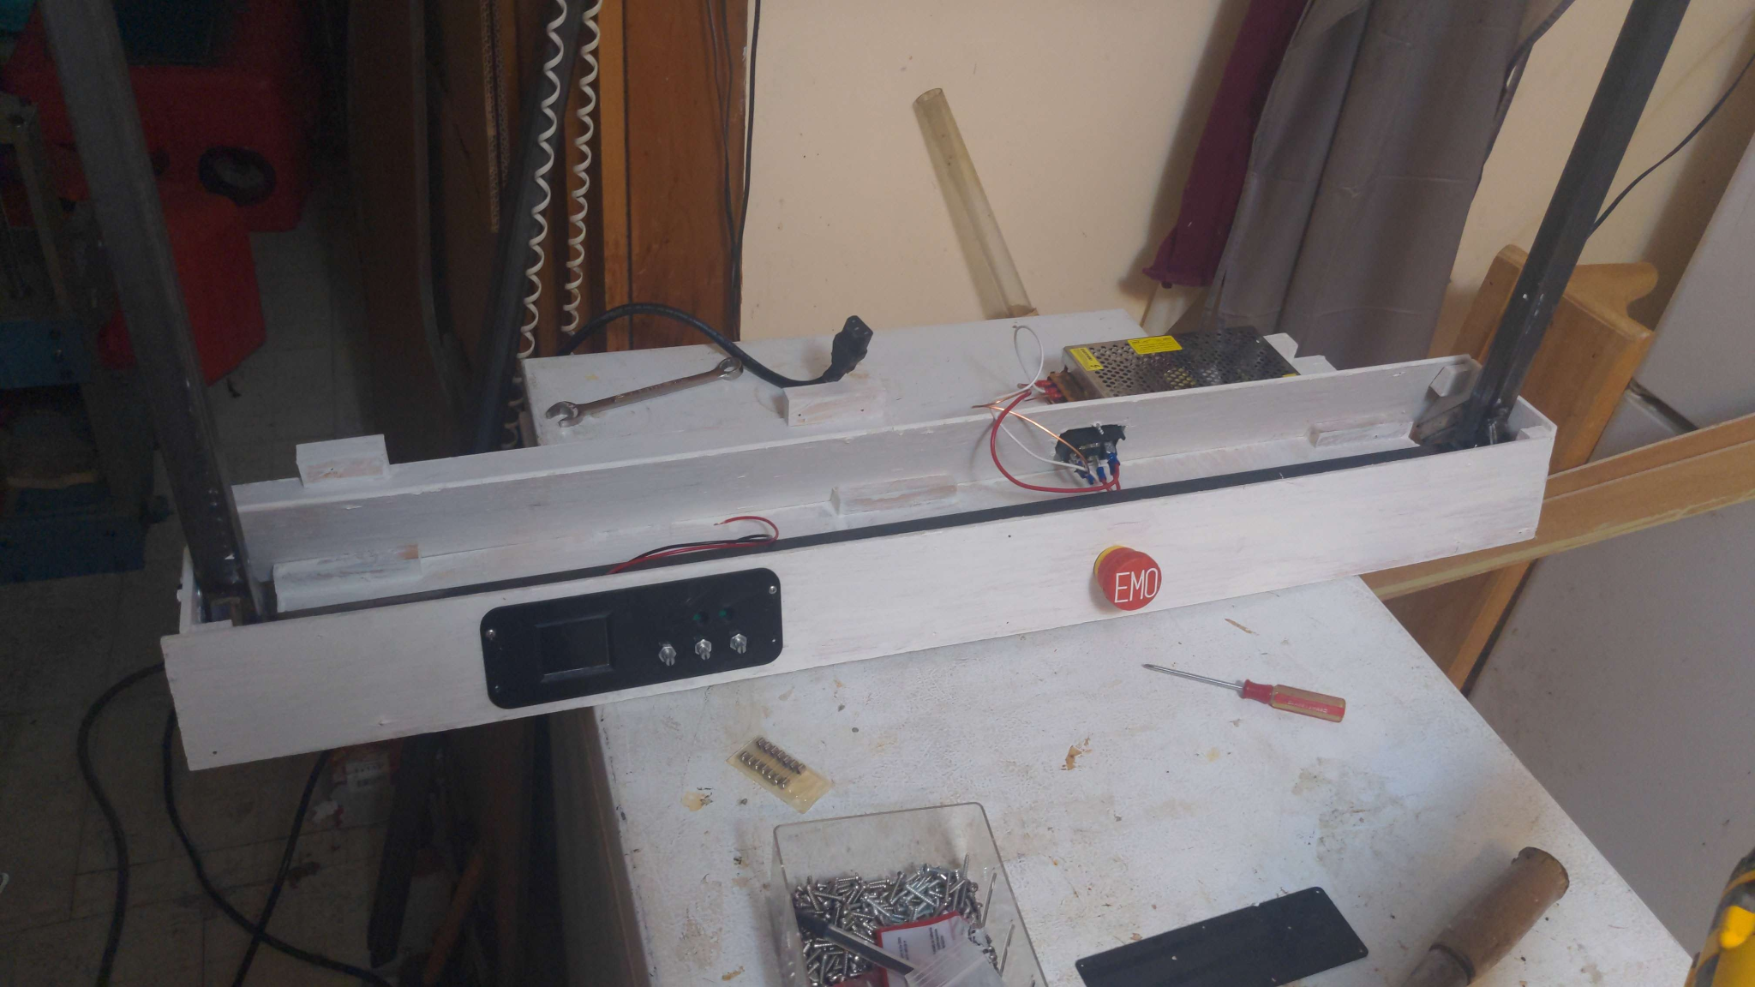
Fabrication and Integration Continued:
Matt

Slide 32
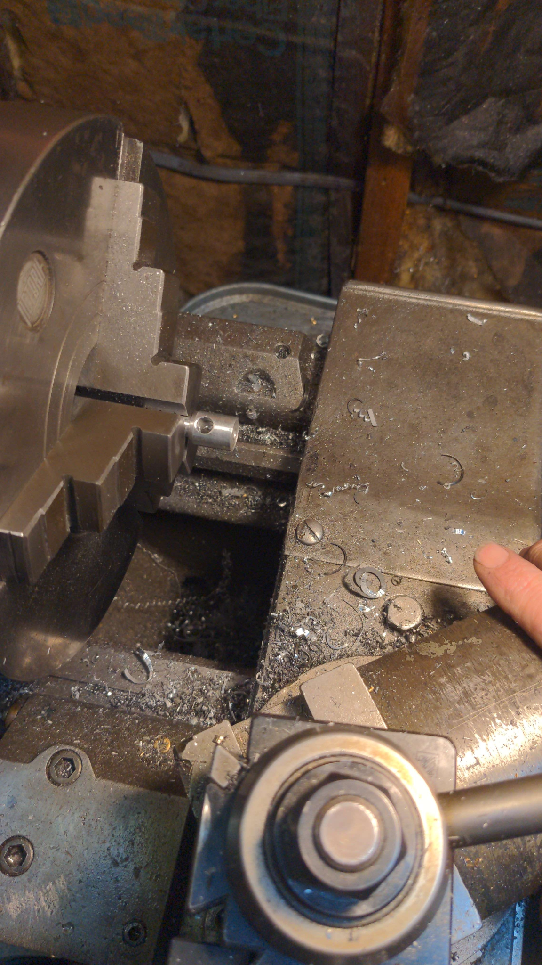
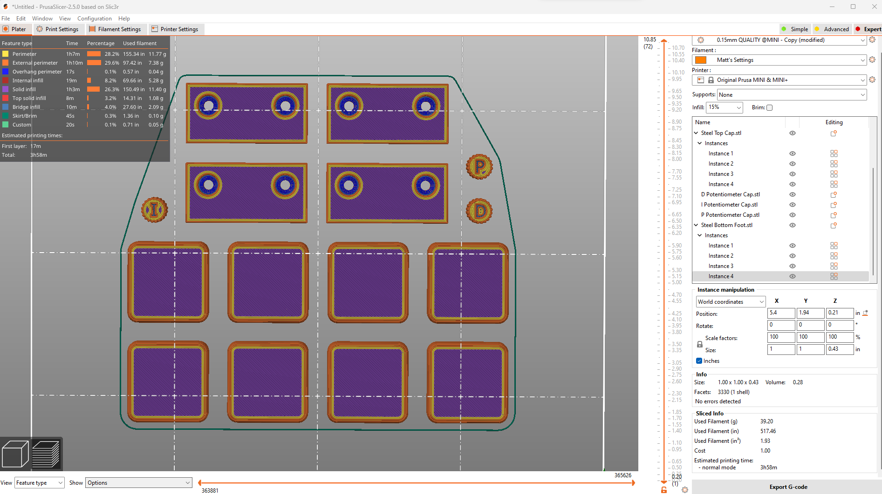
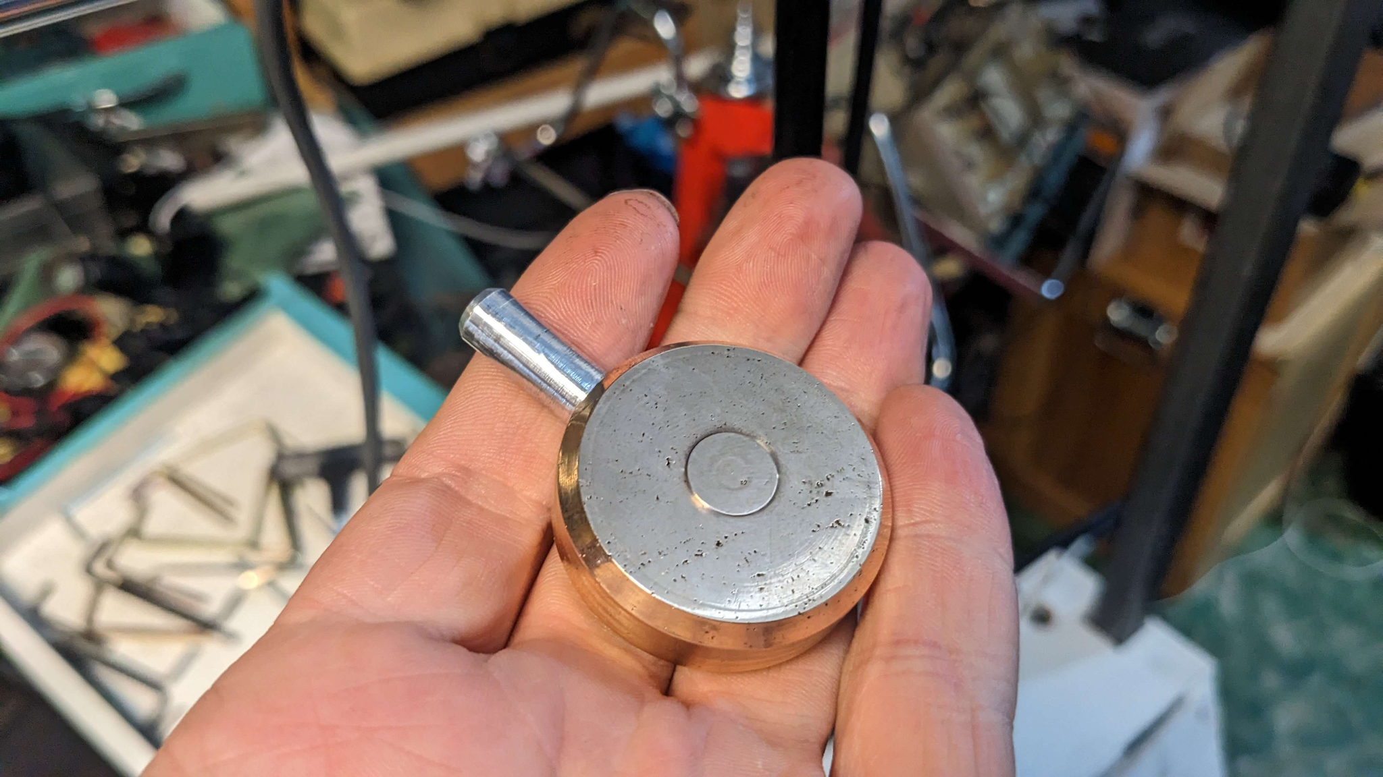
Fabrication and Integration Continued:
Matt

Slide 33
Comprehensive Performance Testing
1.0 Frame Stability
The frame can hold >25lbs without deformation
1.9 All soldered connections are secure
When shaken all pin connections successfully stay in place
1.13 Power
The pendulum stops moving when the power button is pressed
1.16 TFT Screen
The screen displays digital PID calculations and constants with a 30 hz refresh rate
1.17 Leg Fit
Legs were placed into the frame without slip
2.1 Belt Tensioning Assembly
The belt is completely parallel meaning there is no slack
2.5 Electrical internal Temps don't get too high
Internal temperature stays well under 150F
3.1 Test the self balancing PID
The pendulum balances
3.4 Test and ensure harmonic oscillations are working
The pendulum starts in the rest position and can swing itself to the PID loop position
Austin

Slide 34
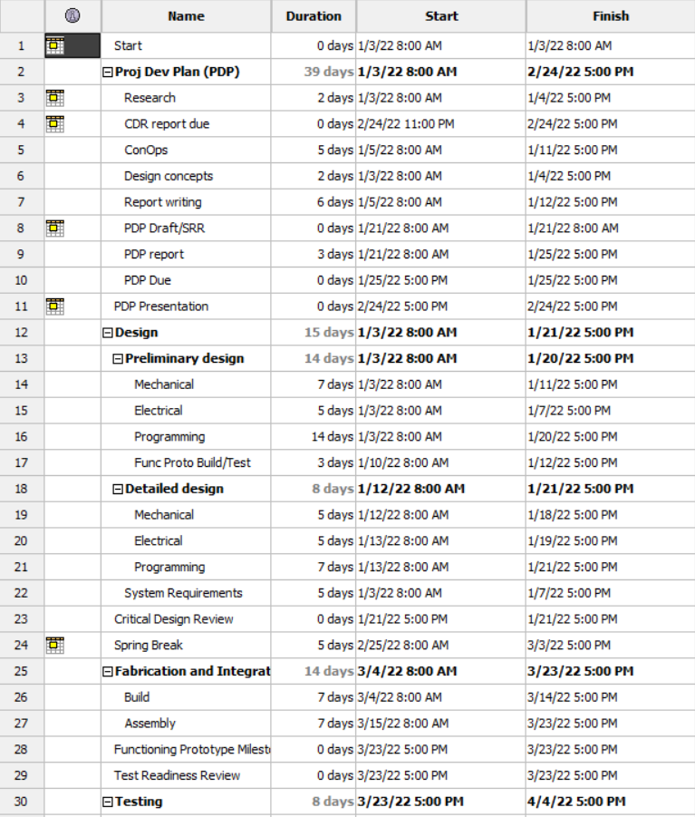
Schedule Milestones
Kat

Slide 35
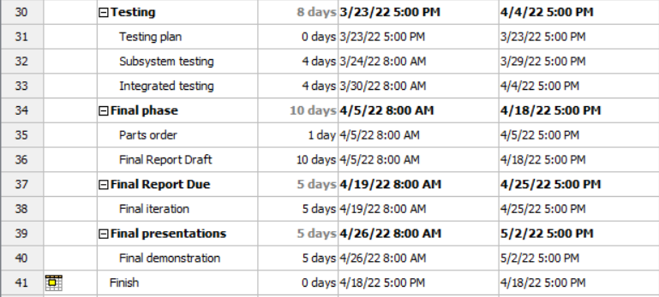
Schedule Milestones (cont.)
Kat

Slide 36
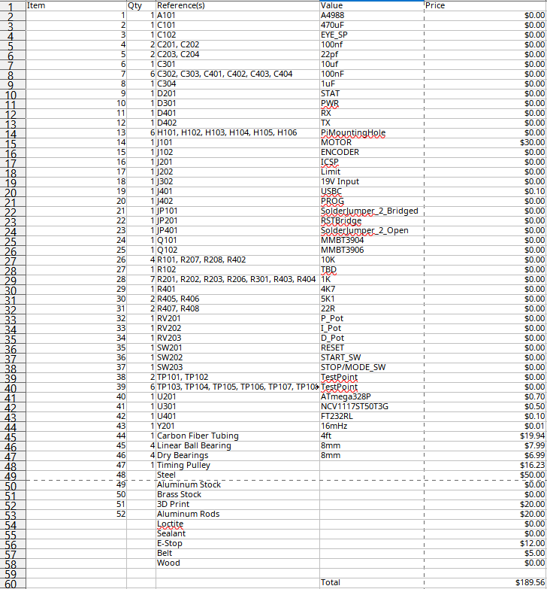
Project Budget
Kat

Slide 37
Lessons Learned
Stepper motors aren’t great for this application: they don’t like rapidly changing variable speeds and low speed operation.
Always have a backup plan to each component
GitHub is a godsend. Having all your files stored in one place and backed up on the cloud makes for a highly iterative and efficient workflow.
Communication is key when working with a team
Should have ordered parts earlier
Austin

Slide 38
Thank you all for your help!
To Professor Husson and Professor Guo:
-Thank you for guiding us through this project and giving us your insight as we met hurdles.
To Professor Carlstrom and Joe Donovan:
-Thank you for funding the project and helping us order parts. Thank you for your insight on how and whether our system will mesh properly.
To Michael Sedutto:
-Thank you for welding our frame and allowing us to use your CNC machine. Without you, we wouldn’t have a mechanical system.
Matt

Slide 39

Questions?

Slide 40
Backup Slides

Slide 41
Reference/Citations
Rotary Inverted Pendulum. Quanser. Retrieved January 22, 2023,
from https://www.quanser.com/wp-content/uploads/2017/03/ROTPEN-graphics.jpg
Lego, Raspberry and Python Project - Reaction Wheel Inverted
Pendulum. (2022, April 16). YouTube. Retrieved January 22, 2023, from https://youtu.be/WObG2LoSEwQ

Slide 42
List and Summary of Analyses
Frame stability - Requirement met
Motor torque and responsiveness - Requirement met
Encoder accuracy - Requirement met
Limit switch proper behavior - Requirement met
Electrical components properly connected and grounded - Requirement met
Motor controller provides enough current - Requirement met
USB-C port for programming - Requirement met
Power supply converts 120V to 12V - Requirement met
3 potentiometers proper behavior - Requirement met
Estop stops operation in less than 10 ms - Requirement met
Power switch turns the system on and off - Requirement met
TFT screen has color display and refreshes - Requirement met
Left slip fit is tight with no wobble - Requirement met
Belt tensioning assembly eliminated belt slip - Requirement met
Sprocket and belt system are square and parallel - Requirement met
Minimal friction between encoder and pendulum - Requirement met
Internal temps stay under 90 C - Requirement met
Pendulum can self balance for more than thirty seconds - Requirement met
TFT screen creates a legible user interface - Requirement met
Pendulum can oscillate itself into a starting position - Requirement met
Pendulum has a user interactive mode where the user can manipulate the P, I, and D constants - Requirement Failed
Users can toggle between different modes - Requirement Failed

Slide 43
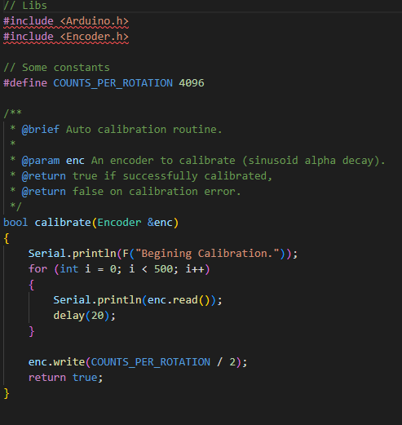
Full Code
Calibrate.h:

Slide 44
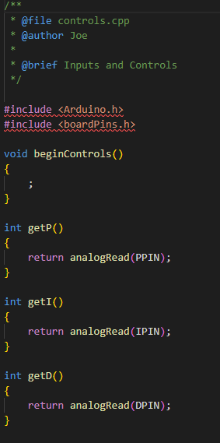
Full Code
controls.cpp:

Slide 45
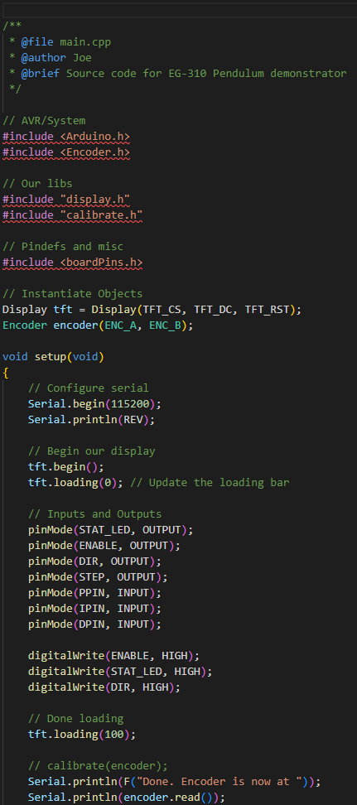
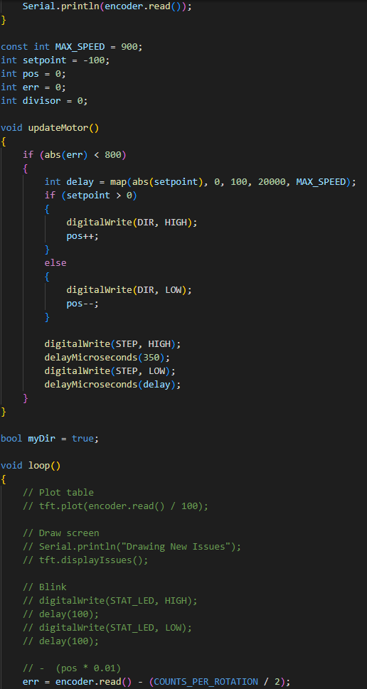
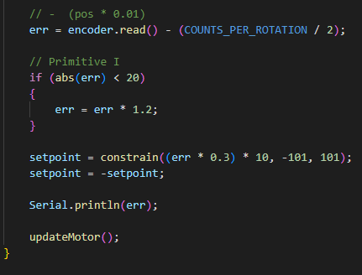
Full Code
main.cpp

Slide 46
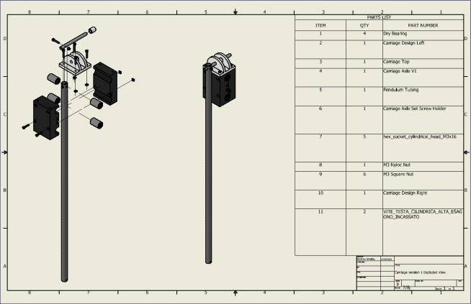

Slide 47
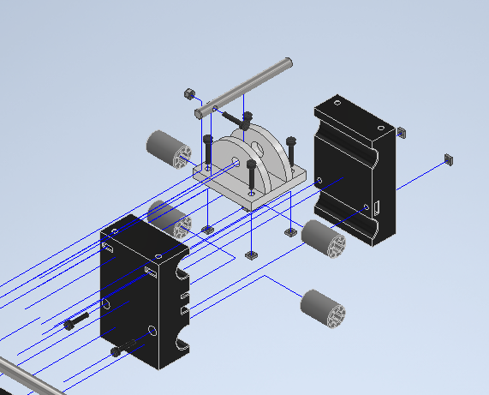

Slide 49



Slide 50


Slide 51


